Slide 1

Ho Chi Minh City University of Technology
Computer Vision EE3077
Hand Gestures Recognition with CNN
Mentor: Pham Viet Cuong
HCMC, 21st August 2021

Slide 2
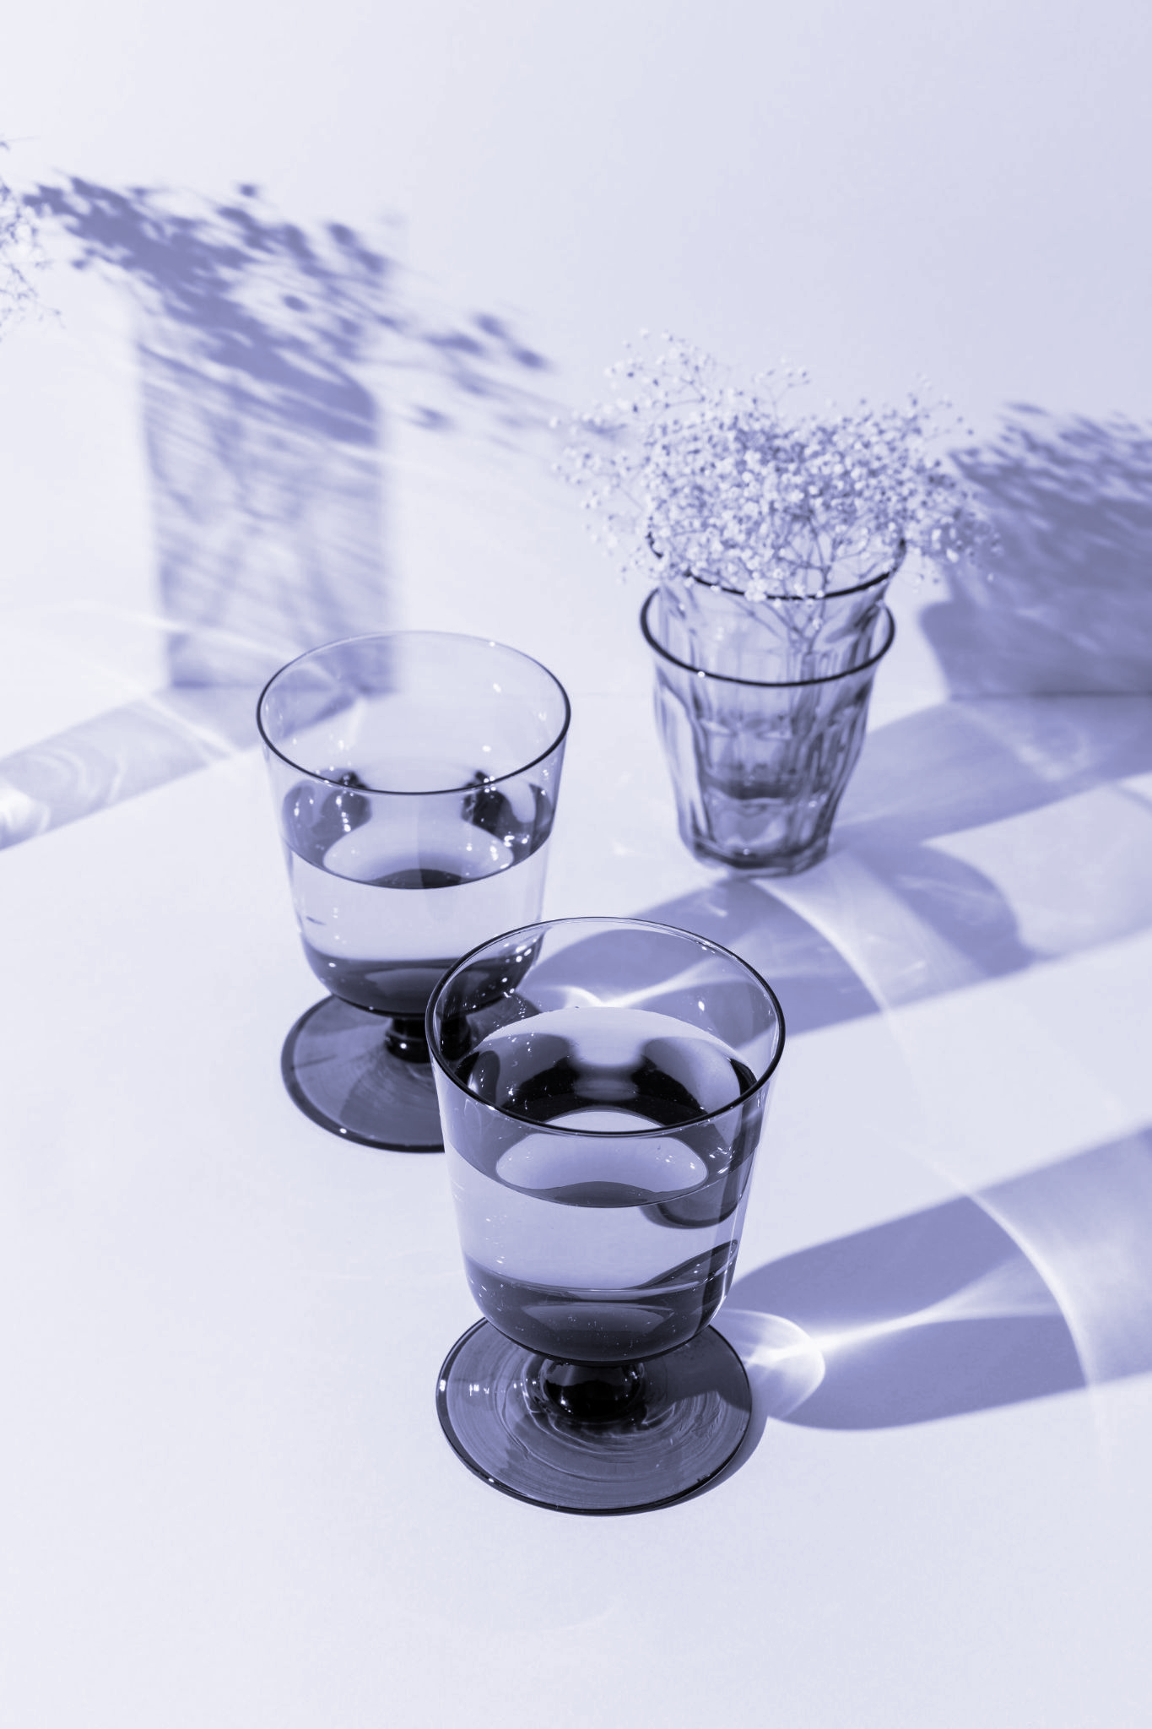
Ho Chi Minh City University of Technology
Group 6
Thái Bảo Khang - 1812560 40% Nguyễn Gia Huy - 1810940 20% Nguyễn Nhật Thắng - 1814099 20% Trương Hồng Vân Khang - 1812566 20%
<number>

Slide 3
01
Introduction
Problem and our solution
<number>

Slide 4
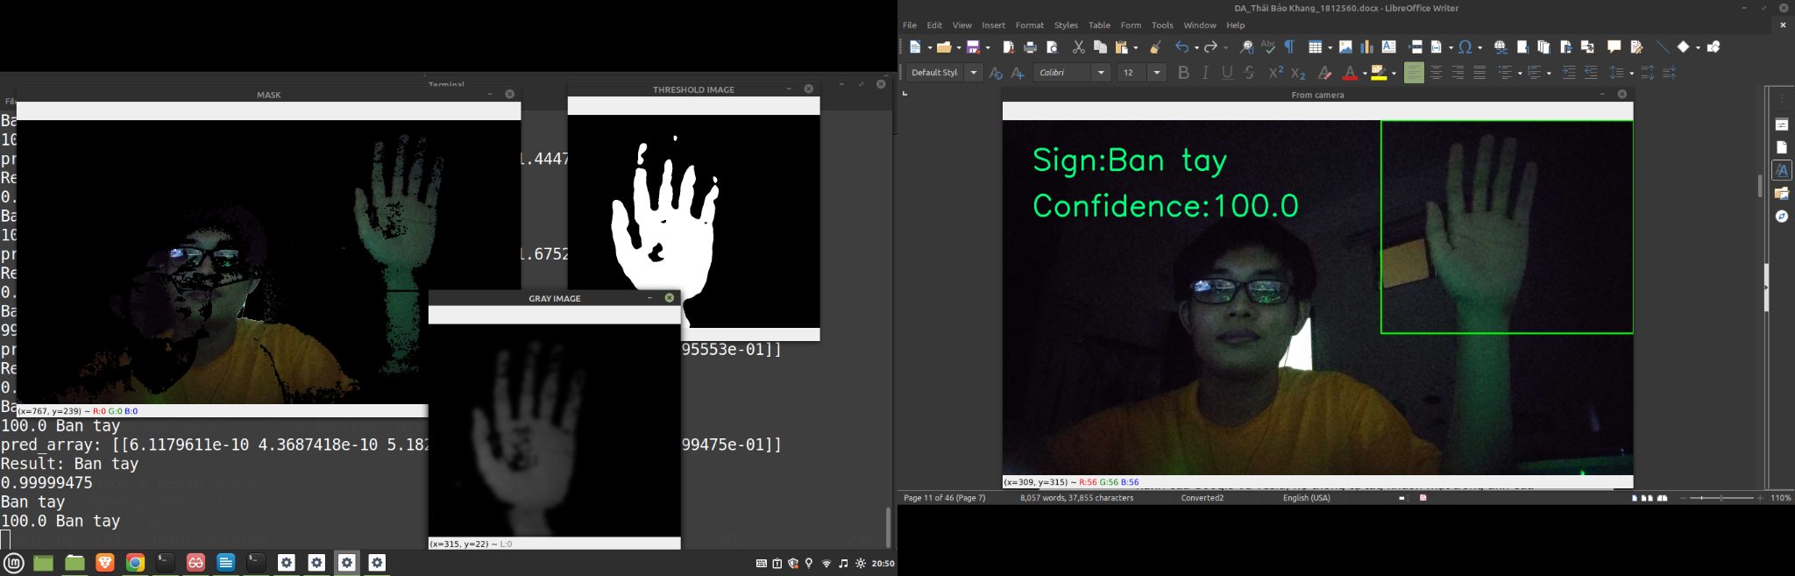
Problem from previous project
Background subtraction algorithm requires a static background, any noises will ruin the image.
<number>

Slide 5
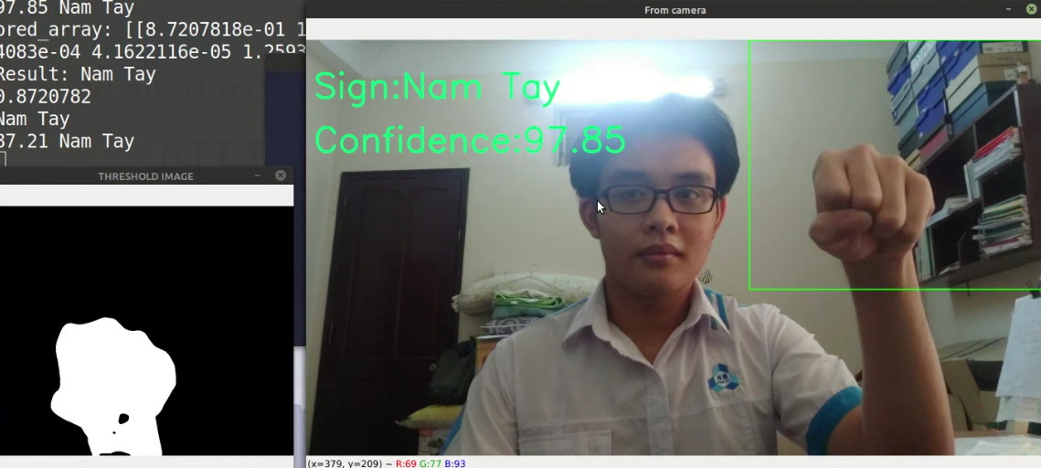
Problem from previous project
Background subtraction algorithm requires a static background, any noises will ruin the image.
<number>

Slide 6
No matter how complex a background is, as long as it’s static then background subtraction alone can do it’s job.
<number>

Slide 7
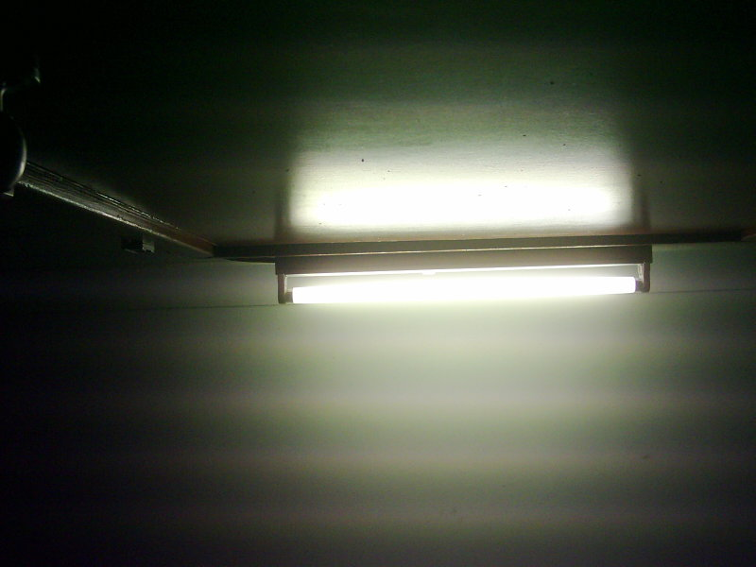
Real life environment has many unknown variables underlying in the background.
(E.g: Artificial lighting, light scattering dust, movement in the background…)
<number>

Slide 8
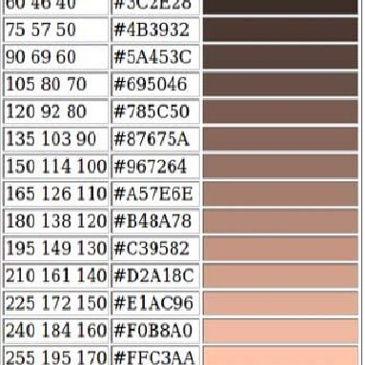
Skin color detection can detect pixels which has it’s value closed to human skin color value
<number>

Slide 9
My proposed method: use both Skin color Detection and Background subtraction to eliminate all moving non-skin objects and static skin-like color objects
<number>

Slide 10


Tool used
Python 3.7
Google Colaboratory
NVIDIA Tesla K80 GPU
<number>

Slide 11


Library used
DIP
DL
Opencv-python
4.5.1.48
Tensorflow
2.5.0
<number>

Slide 12
02
Algorithm
Implementation
<number>

Slide 13
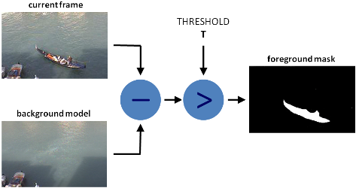
Background Subtraction
<number>

Slide 14
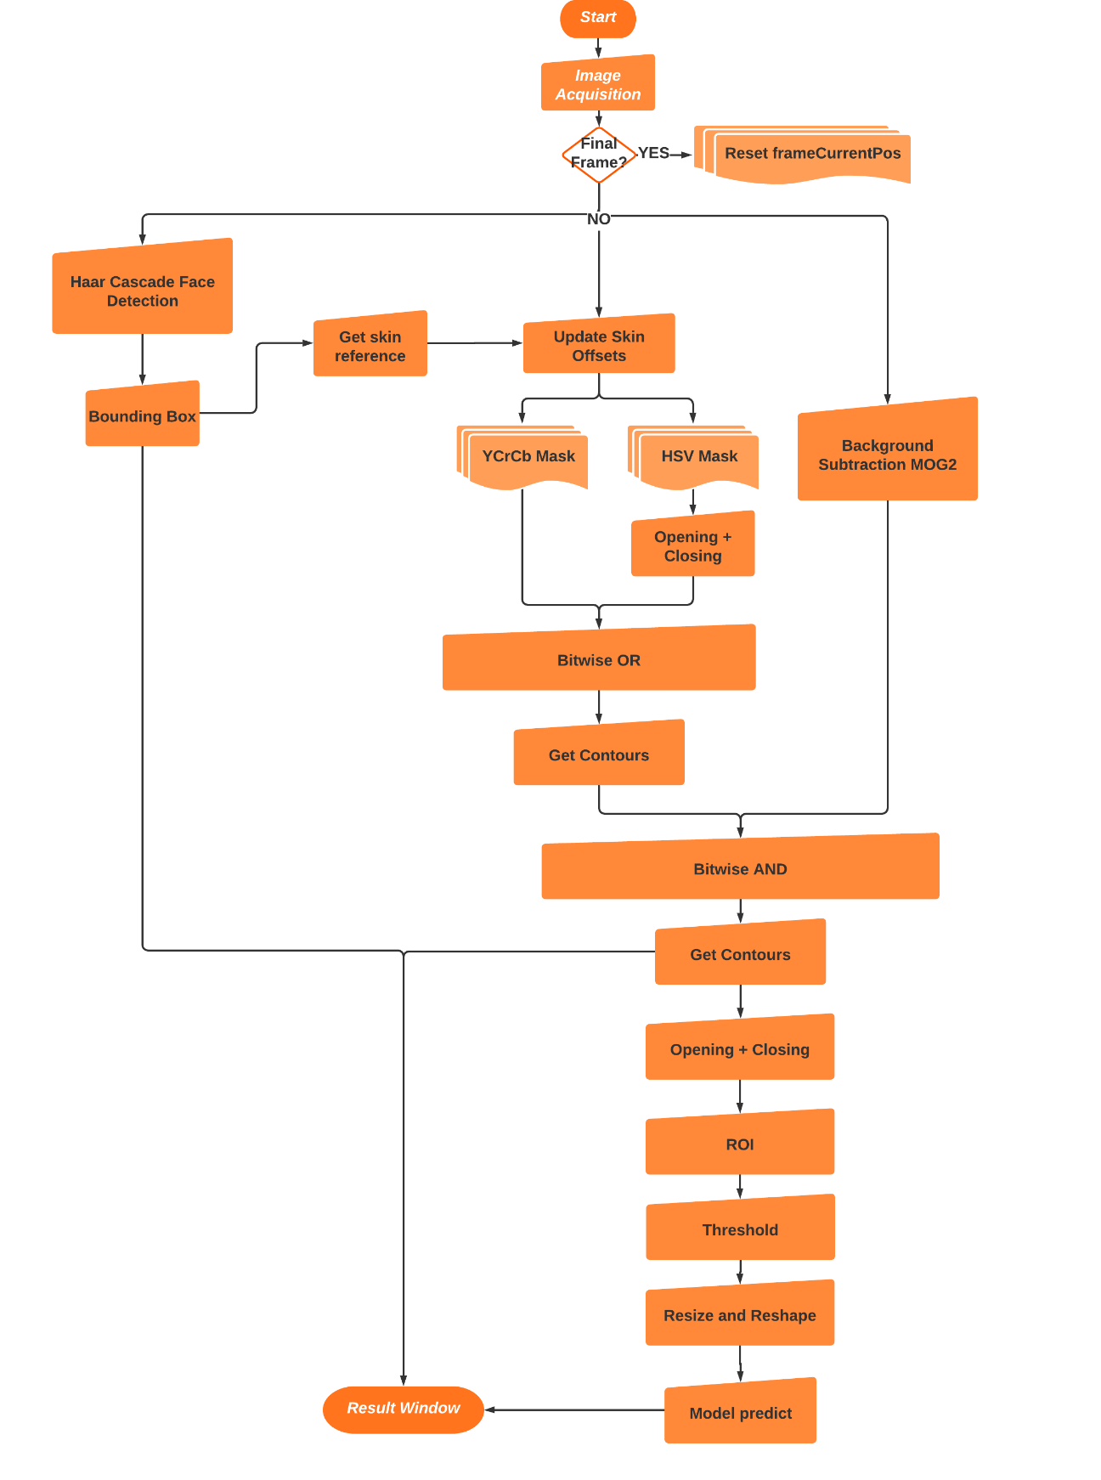
<number>

Slide 15
<number>

Slide 16
<number>

Slide 17
<number>

Slide 18
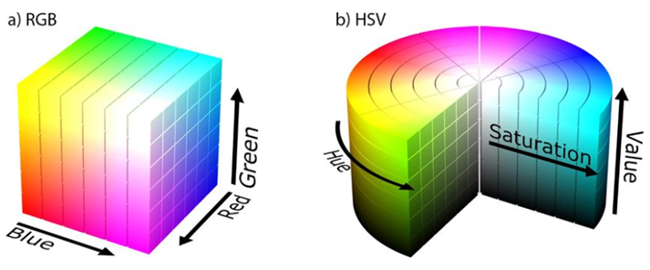
RGB and HSV
<number>

Slide 19
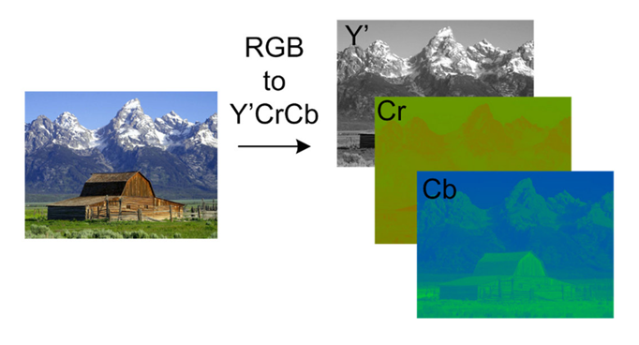
RGB and YCrCb
<number>

Slide 20
Effects of different color space
Different lighting conditions only affect Value and Saturation, Hue stay almost the same so I can use this to maintain robustness in different real life scenarios.
Similar to YCrCb.
<number>

Slide 21
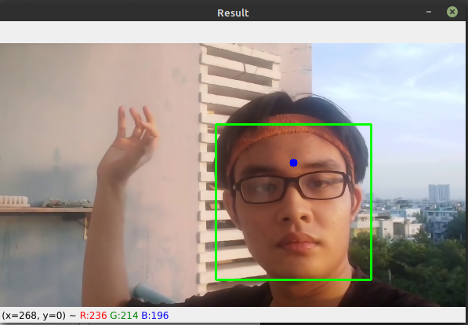
(209, 179, 168)
HSV(16, 19.6, 82)
(130, 69, 50)
HSV(14, 61.5, 51)
<number>

Slide 22
Threshold
150<Cr<200; 100<Cb<150
(Khamar et al. , 2015)
132<Cr<173; 76<Cb<126
(Mohamed, 2015)
110<Hue<150 và 20<Saturation<60 or
130<Hue<170 và 30<Saturation<130
(Trong-Nguyen Nguyen, 2013)
<number>

Slide 23
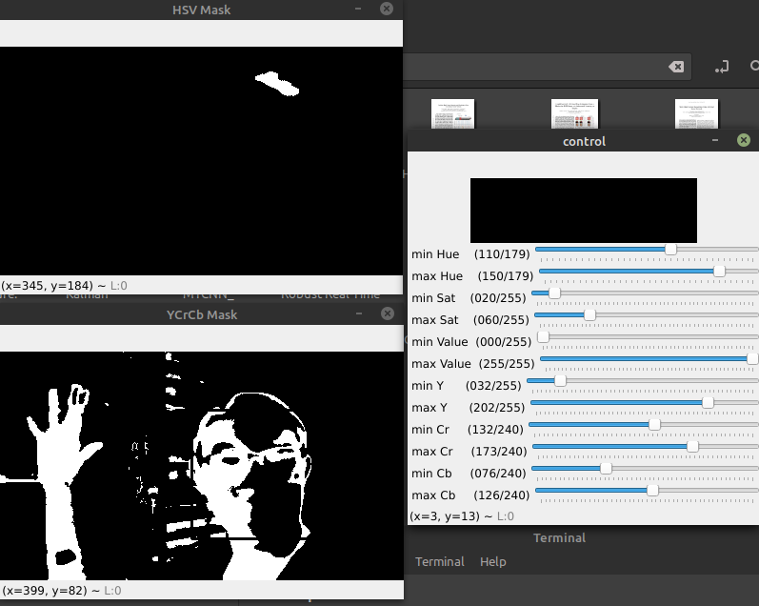
<number>

Slide 24
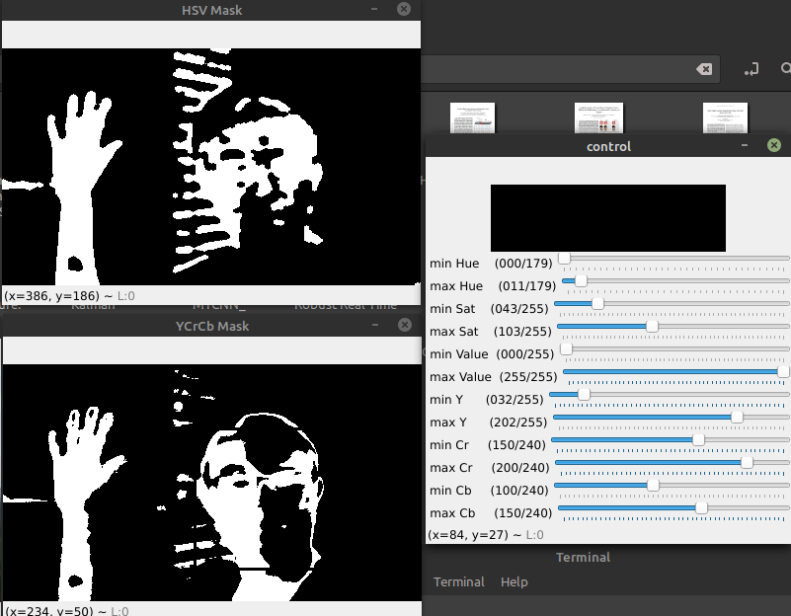
<number>

Slide 25
36 pixels area means value:
Hue = 10, Sat = 148, Val = 165, Cr = 167, Cb = 100
Manual measured by control panel:
0<Hue<15
58 < Sat < 151
70 < Val < 225
147 < Cr < 159
95 < Cb < 138
<number>

Slide 26
Which mean we have to complement an
offset value to keep minHue = 0 and
maxHue = 15
Thus:
minHueUpdated = meansHue – 10
maxHueUpdated = meansHue +5
Same for the rest, we have:
<number>

Slide 27
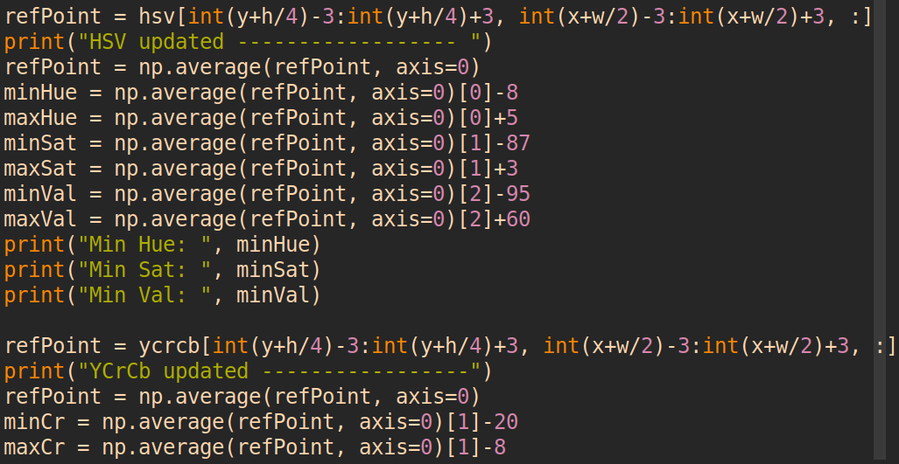
<number>

Slide 28
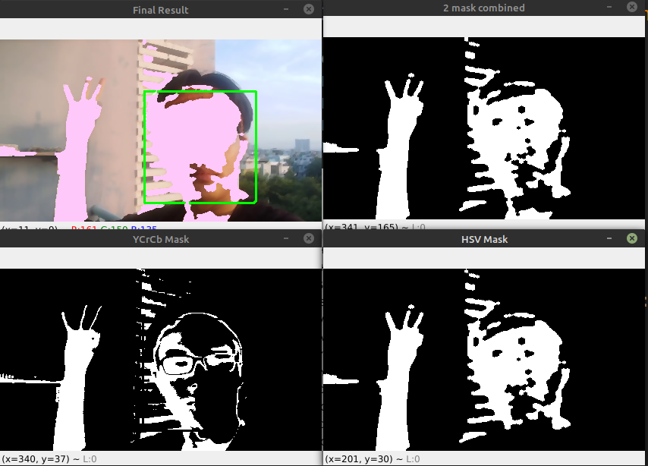
<number>

Slide 29
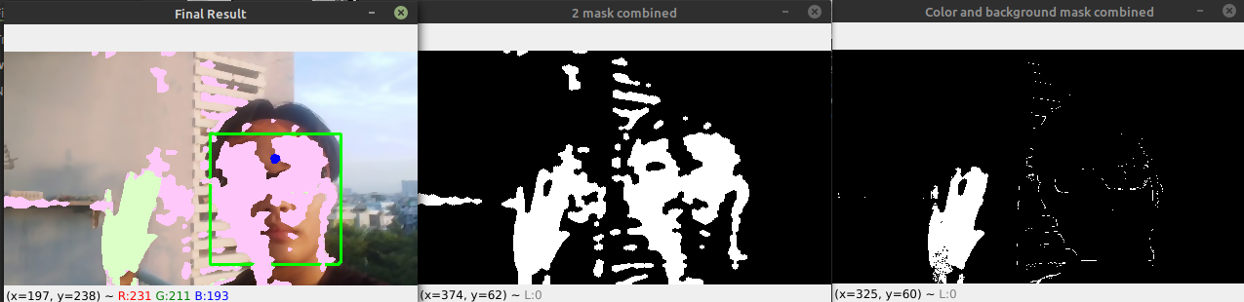
Result - 2 Mask - background mask
<number>

Slide 30
03
Model
Training model
<number>

Slide 31
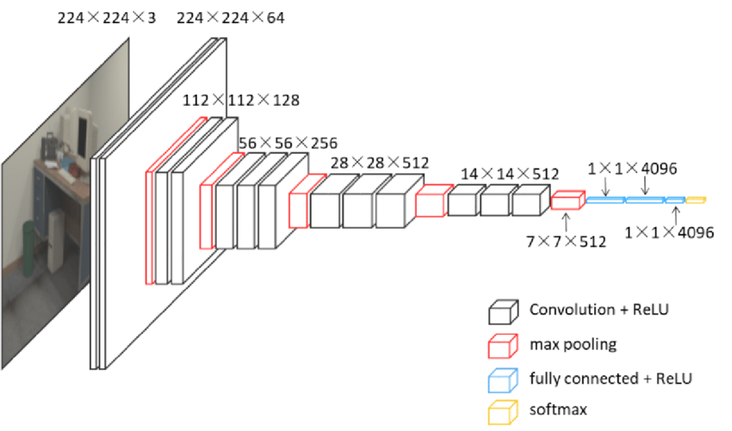
VGG16 Architecture
<number>

Slide 32

imageNet dataset
<number>

Slide 33
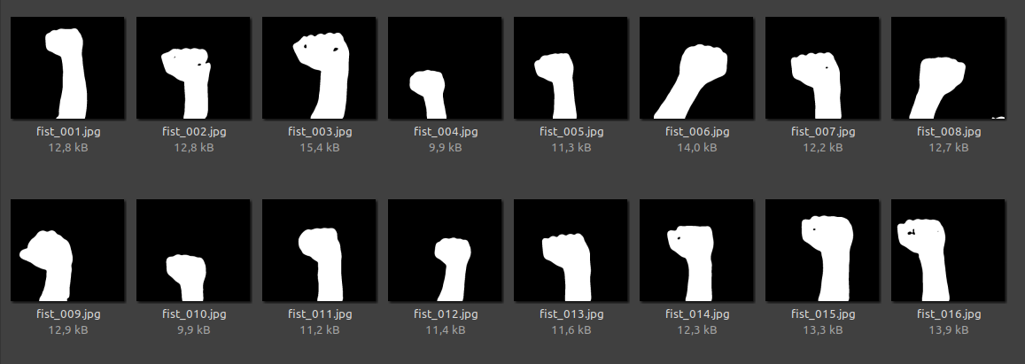
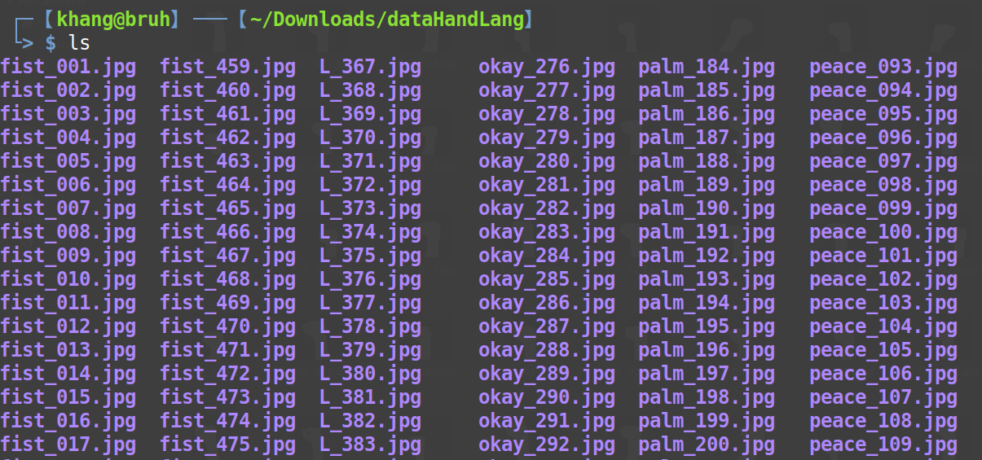
Preparation
Dataset with 2748 images for 5 types of gestures
<number>

Slide 34





Gestures type
Nắm đấm
Chữ L
OK
Bàn tay
Chữ V
<number>

Slide 35
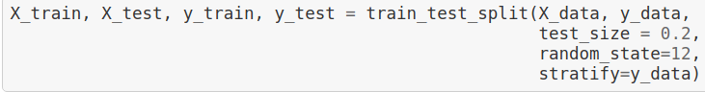
Prepare train and test set by spitting 80/20
<number>

Slide 36
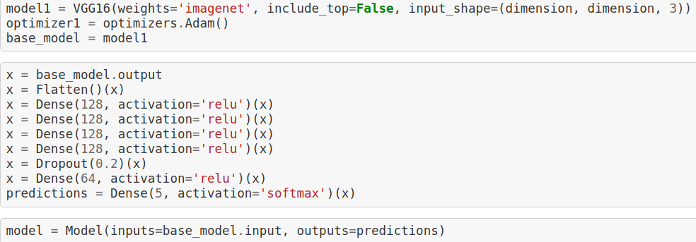
Model init
<number>

Slide 37
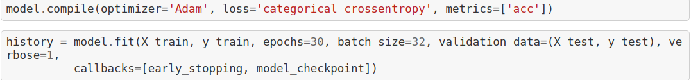
Start training
Optimizer Adam, Loss function categorical cross entropy and train for 30 epochs,
Early Stopping when there are sign of overfit
<number>

Slide 38
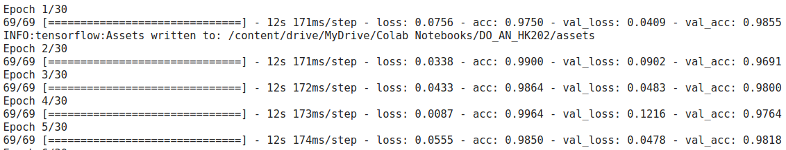
Model training
Early epochs training results were acceptable
Focus on validation accuracy
<number>

Slide 39
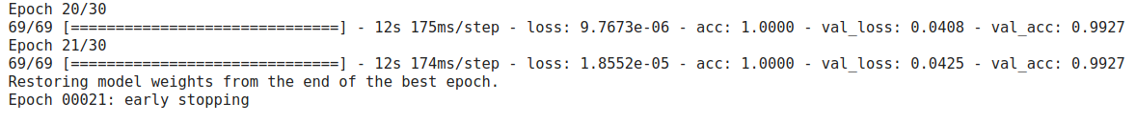
train model
At epoch 21, validation loss started to rise indicate sign of overfitting
Restore best model at epoch 12
<number>

Slide 40
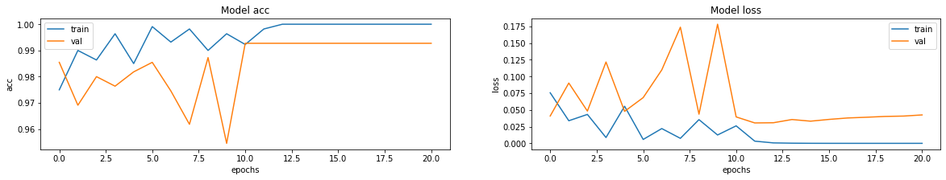
Training result
<number>

Slide 41
04
Result
Evaluation
<number>

Slide 42
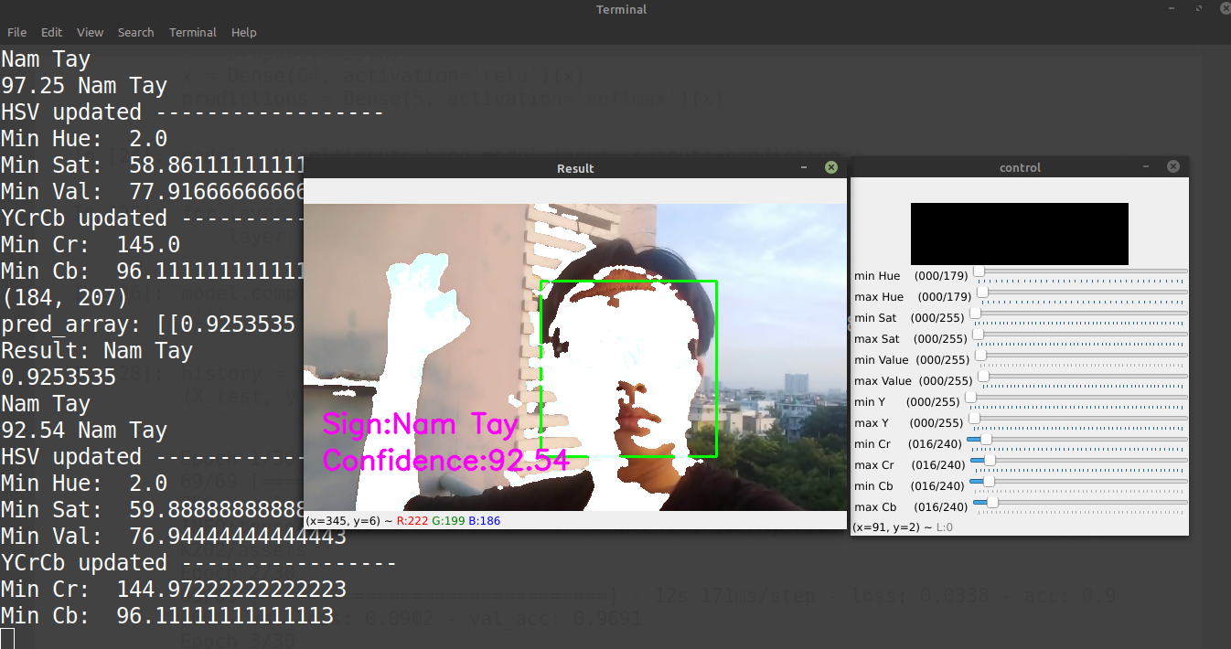
Demo
<number>

Slide 43
What we have accomplished
Our new model can endure small vibration such as shaking hand, unstable camera stand,... and subtle changes in background such as leaves, birds,... which is an advancement compared to previous model.
<number>

Slide 44
Problem we encountered
For hand texture reference required face recognition
Still unable to actively tracking hand location
May mistake skin - related color object if they aren’t static
Very slow processing time (~0.1 FPS)
<number>

Slide 45
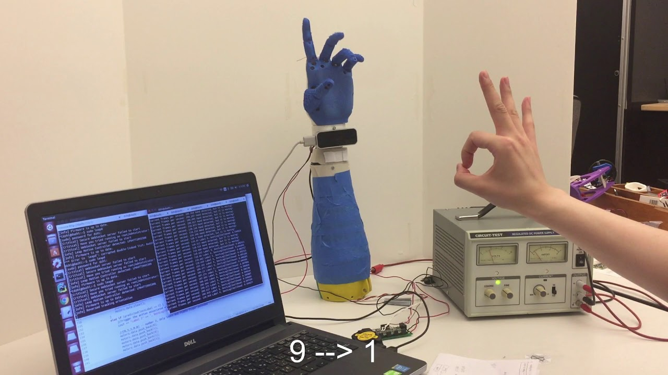
Use case
HCI
Human Computer Interaction
<number>

Slide 46
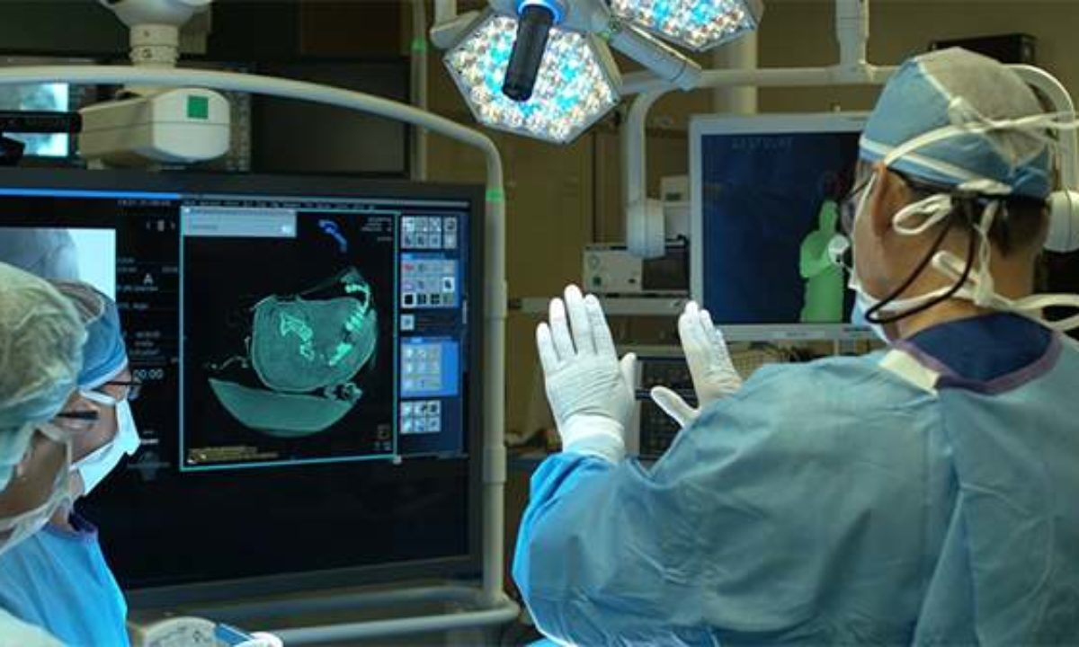
Use case
Medical
Help doctor communicate with machine easely
<number>

Slide 47
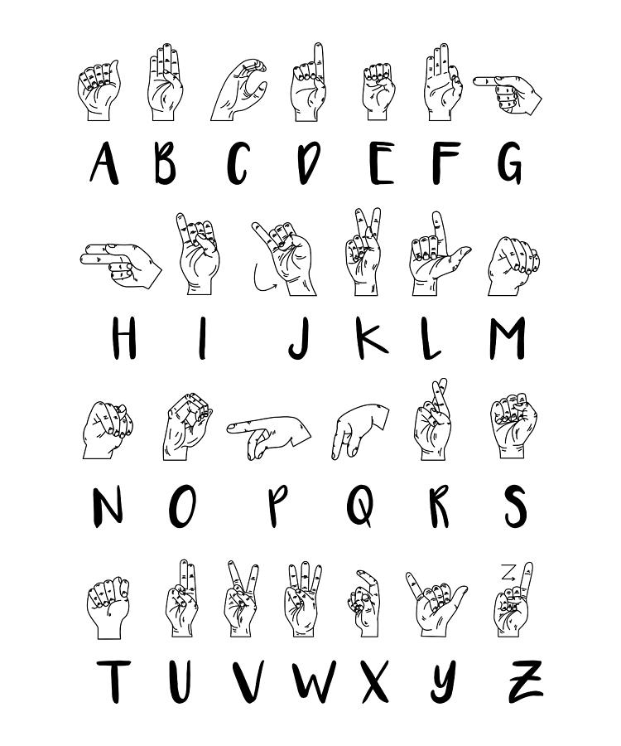
Use case
Translation
Gesture language translator
<number>

Slide 48
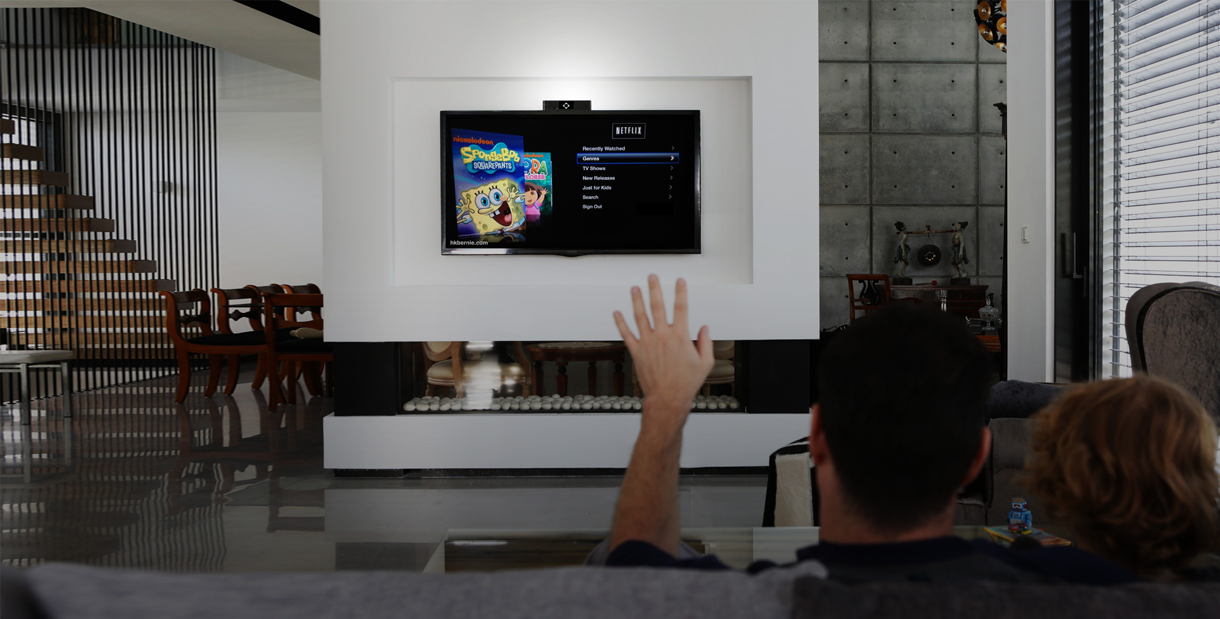
Use case
Smarthome
Remote control IoT devices withou controller
<number>

Slide 49
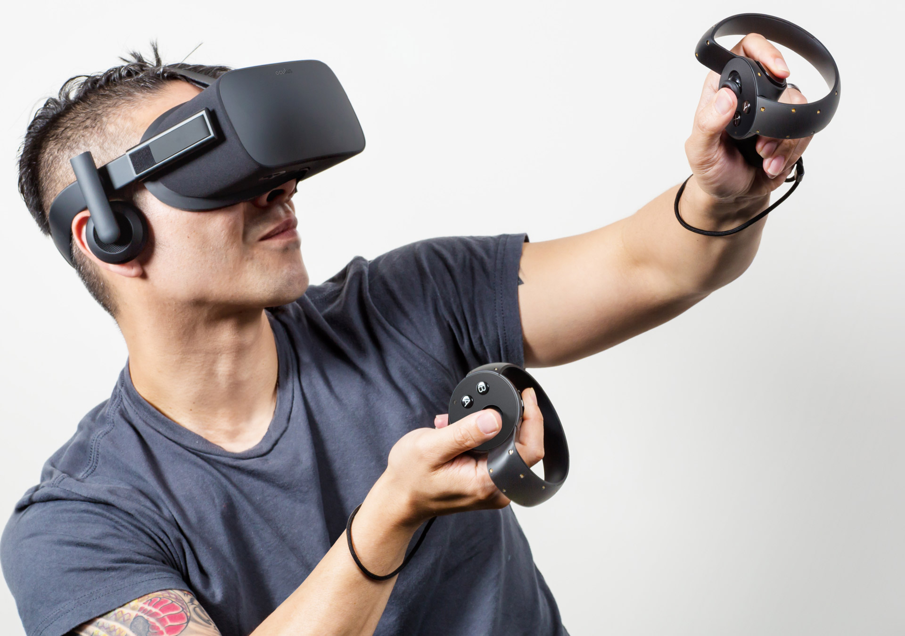
Use case
Entertainment
Experience VR/AR without hardware restriction
<number>

Slide 50
Thank you for your attention
GROUP 6
Please keep this slide for attribution
<number>

